Slide 1
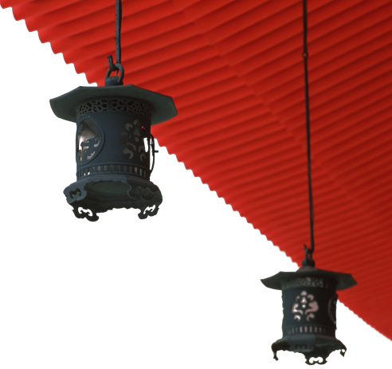


中国文化概况
A GLIMPSE OF CHINESE CULTURE

Slide 2
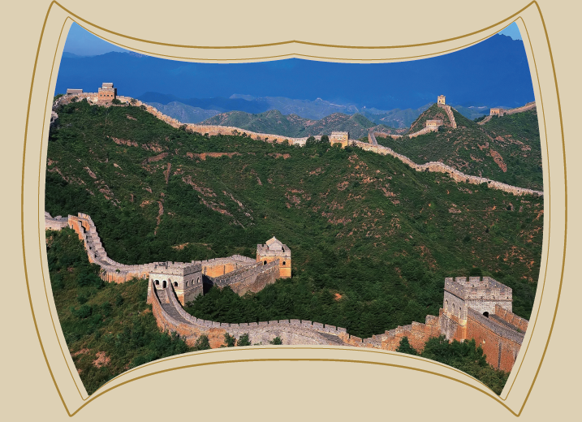
Chapter 12
World Heritage Sites

Slide 3

学习目标
了解世界遗产名录中的中国遗产
掌握中国自然文化遗产概况
增强保护中国自然文化遗产的意识

Slide 4

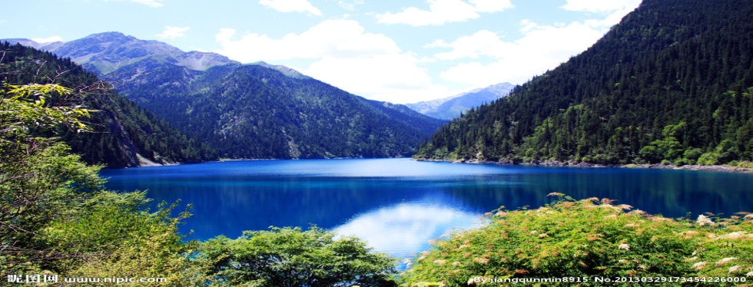
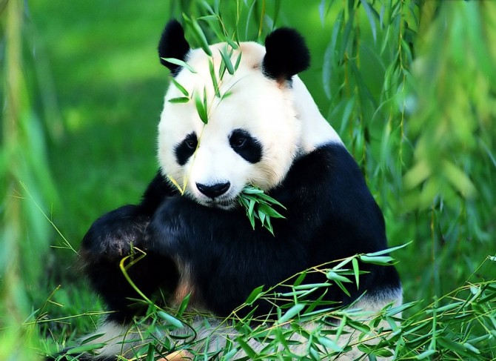
1
2
Overview
3
Lead-in Activity
World Heritage
in China
Discussion &
Presentation

Slide 5
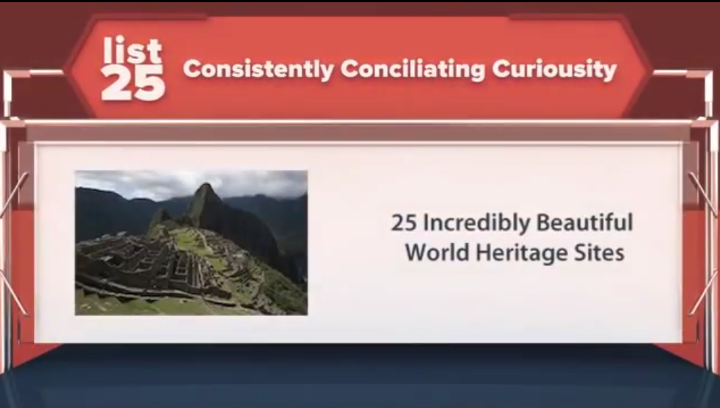
Lead-in Activity
Watch & Think
Watch the video and discuss：
Do you any World Heritage Site in China?
Do you prefer a natural heritage or a cultural heritage? Why?

Slide 6
1
2
Overview
3
Lead-in Activity
World Heritage
in China
Discussion &
Presentation

Slide 7
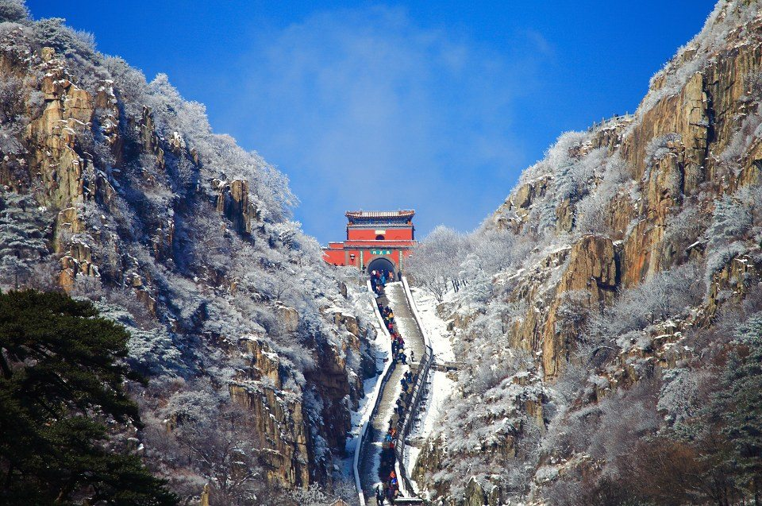
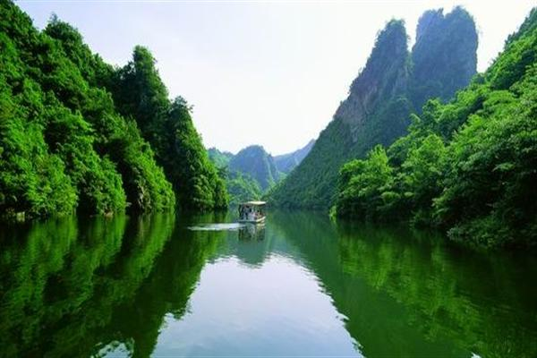
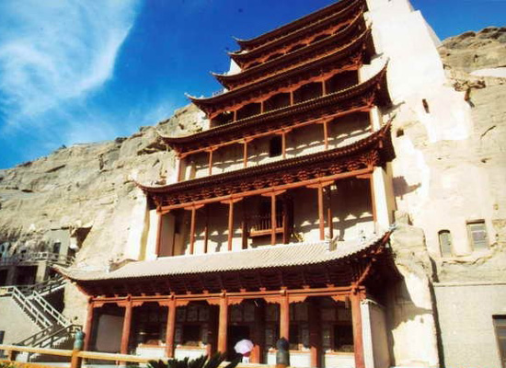
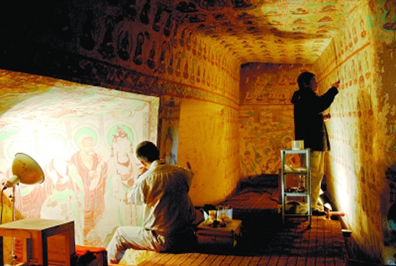
World Heritage in China
1
2
3
4
Cultural & Natural Heritage
Natural Heritage
Cultural Heritage
Preservation

Slide 8
World Heritage in China
The World Heritage List
established under terms of the Convention Concerning the
Protection of the World Cultural and Natural Heritage(《保
护世界文化和自然遗产公约》) adopted in 1972 by UNESCO.
China acceded to the Convention in 1987.
World Heritage Sites in China
45 Sites in China are on the World Heritage List by UNESCO
(Dec. 2013)
31 cultural heritages
10 natural heritages
4 dual heritages
2021年，56项
2023年，57项（31 cultural heritages
These sites are the most essential part of China’s valuable and
rich tourism resources.
China also has rich non-material cultural heritage.

Slide 9
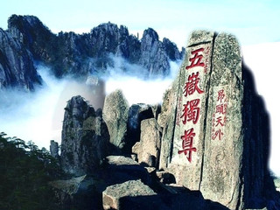
Cultural and Natural Heritage
Mount Taishan
inscribed on the UNESCO World Heritage List in 1987.
the leader of the “Five Sacred Mountains” in China
situated in the centre of Shandong province
place for emperors to pray when ascending the throne
source of inspiration for many poets and literary scholars
the symbol of spiritual culture of China
a perfect combination of cultural relics and natural scenery

Slide 10
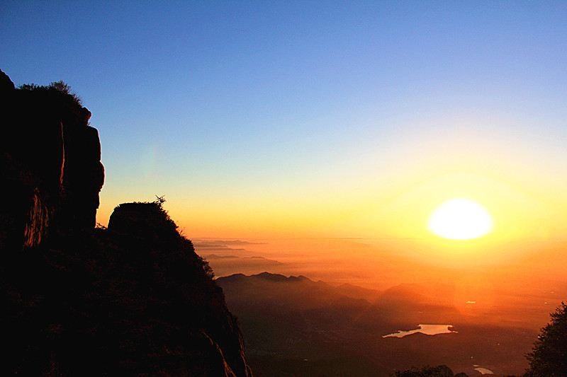

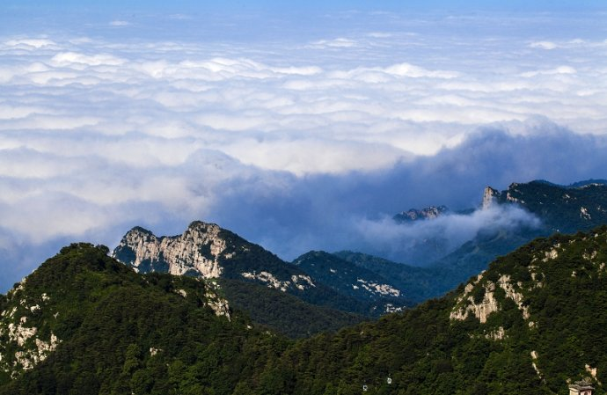
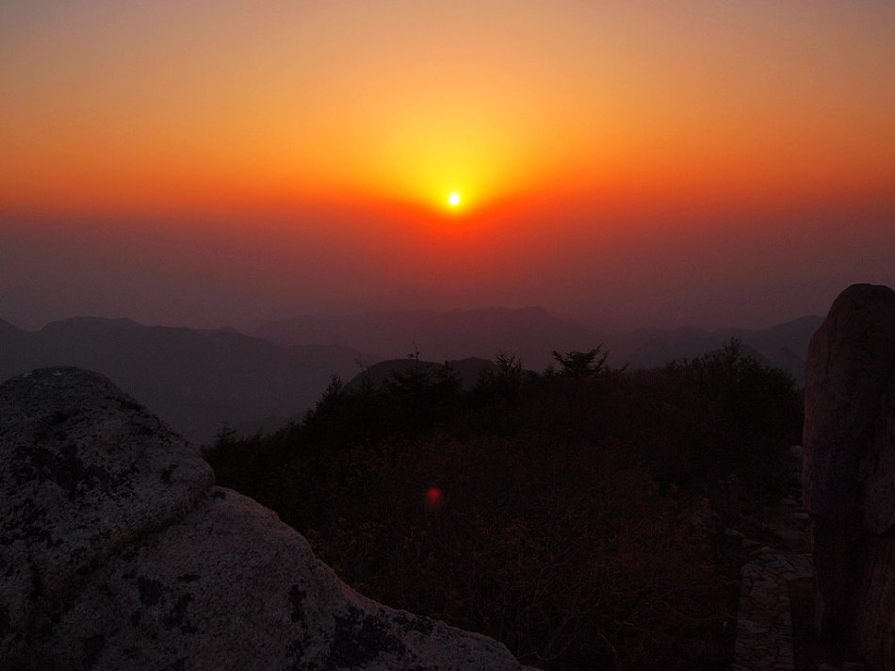
Cultural and Natural Heritage
the Sea of Clouds
the Sunset in the West
the golden-belt-like Yellow River
Mount Taishan’s four spectacular views
the Sunset glow

Slide 11

Cultural and Natural Heritage
Mount Huangshan
lies in Huangshan city, Anhui province
known worldwide for its four wonders:
the fantastic pines（奇松）,
the grotesque rocks（怪石）,
the sea of clouds（云海）,
the hot springs（温泉）.
earns itself the name “Earthly Fairyland”.

Slide 12
Cultural and Natural Heritage
Mount Emei
one of the four Buddhist mountains in China
The main scenic spots on the mountain are the Baoguo Temple（保国寺）, the Fuhu Temple（伏虎寺）, the Qingyin Pavilion（清音阁）, the Golden Summit（金顶）, etc
a well-known natural museum with some 5,000 species of plants and 2,300 types of animals.
also famous for its Giant Buddha statue, which is said to be the largest Buddha statue in the world.
The way in which the cultural features have been integrated with the natural scenery is considered to be a precious legacy.

Slide 13
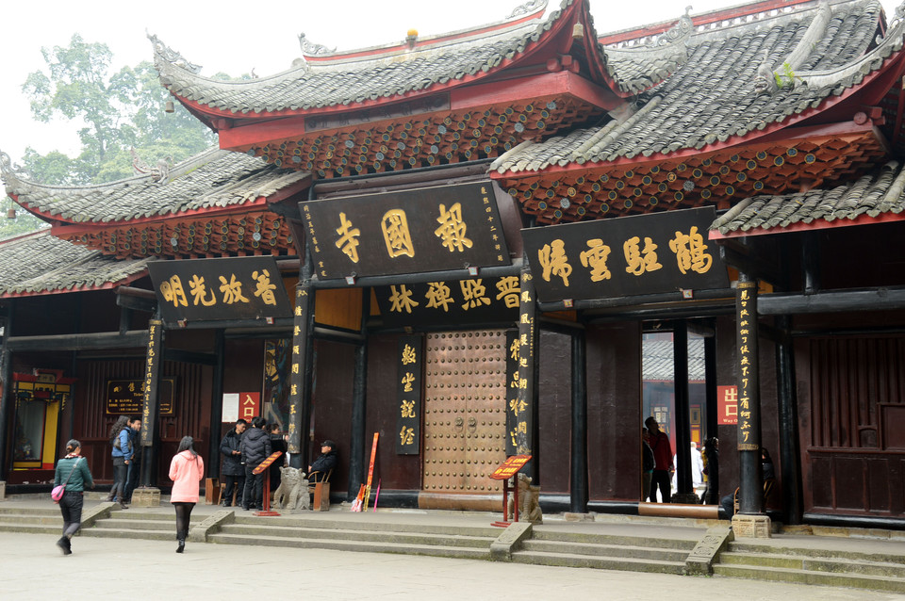
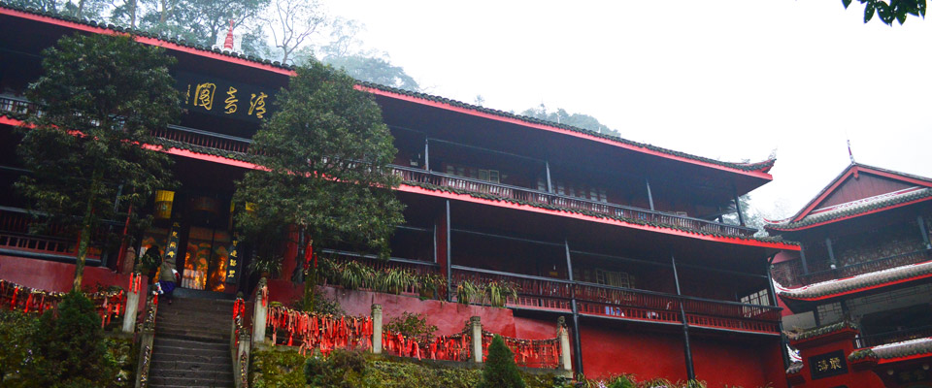
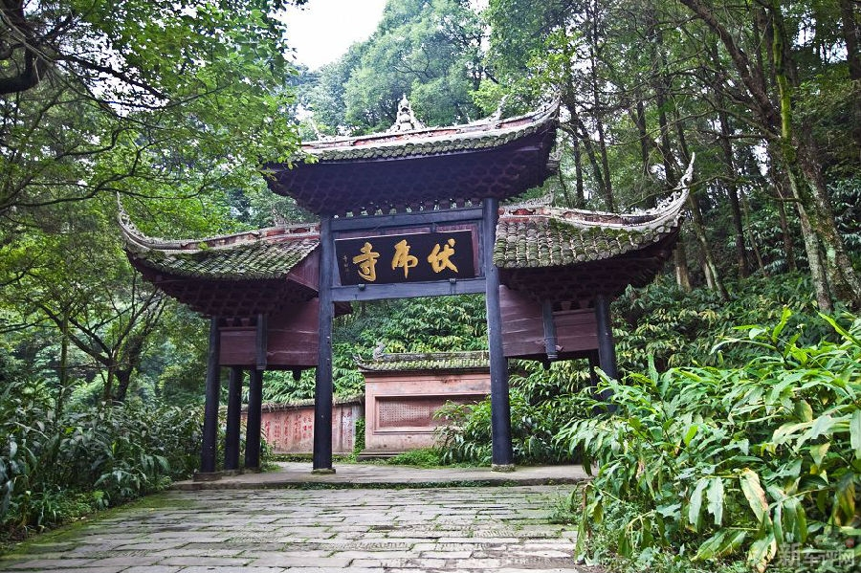
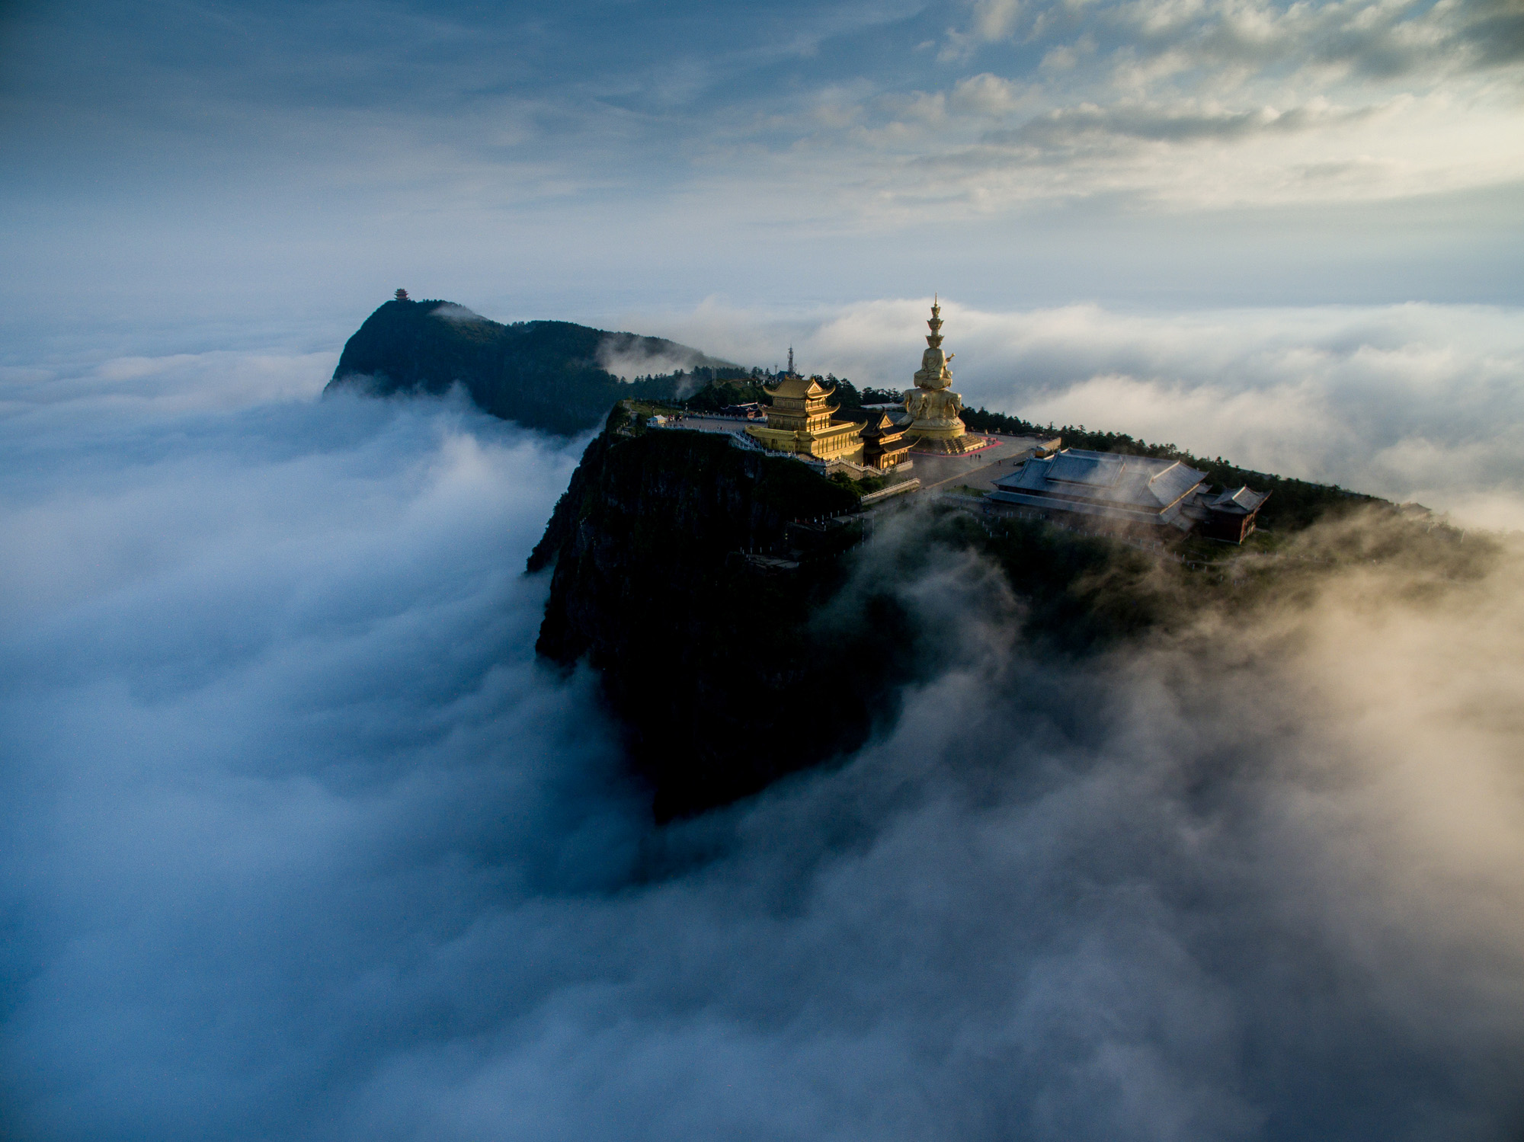
Cultural and Natural Heritage

Slide 14
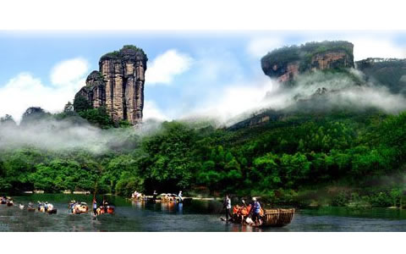
Cultural and Natural Heritage
Mount Wuyi
Located south of Wuyishan city, Fujian province
subtropical virgin forests and many attractions of exceptional scenic quality
also known for its great historic and cultural value

Slide 15
World Heritage in China
1
2
3
4
Cultural & Natural Heritage
Natural Heritage
Cultural Heritage
Preservation

Slide 16
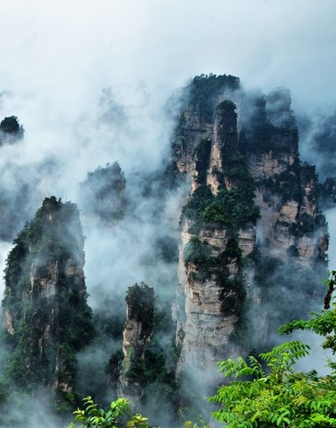
Natural Heritage
Wulingyuan (武陵源) Scenic and Historic Interest Area
located in the northwest of Hunan province
has geologic structures of outstanding value, beautiful physical contours, complete ecosystem, rare cultural relics and various climates and scenes
three parts:
the Zhangjiajie National Forest Park,
the Suoxiyu Natural Resource Reserve ,
the Tianzishan Natural Resource Reserve.
The most distinctive landscape of this area are the over 3,000 bizarre peaks.

Slide 17
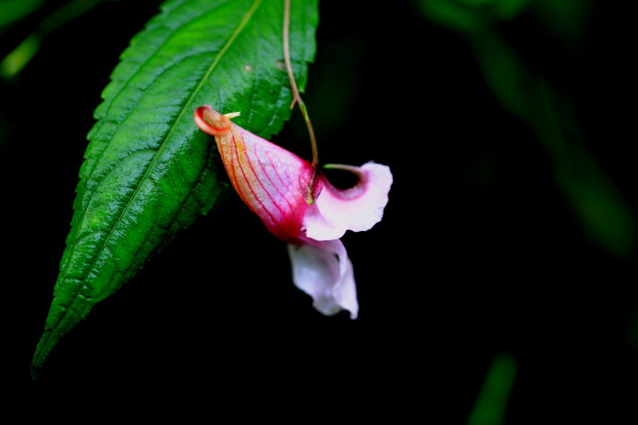
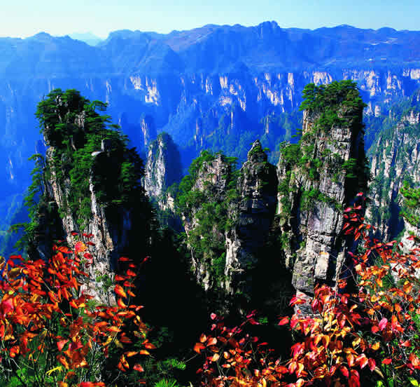
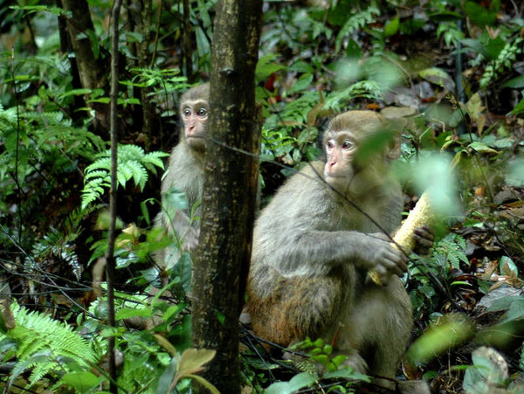
Natural Heritage
Wulingyuan (武陵源) Scenic and Historic Interest Area
It is home to over 3,000 species of plants, more than 700 types of trees, up to 450 kinds of ornamental flowers, and about 116 species of vertebrates ( 脊椎动物) falling into 50 families. Moreover, hundreds of species of animals are found here.

Slide 18

Natural Heritage
Jiuzhaigou Valley Scenic and Historic Interest Area
lies in the southern part of the Minshan Mountains ( 岷山) in Nanping county, Sichuan province.
got its name because there are nine Tibetan villages in the valley
often called as the “Fairyland on Earth”.
is also home to over 220 bird species as well as
a number of endangered plant and animal species.

Slide 19
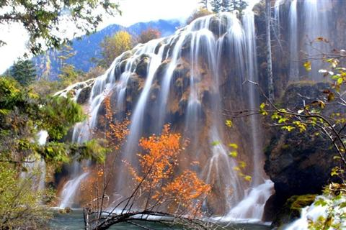
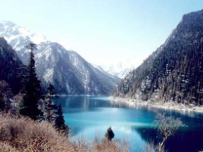
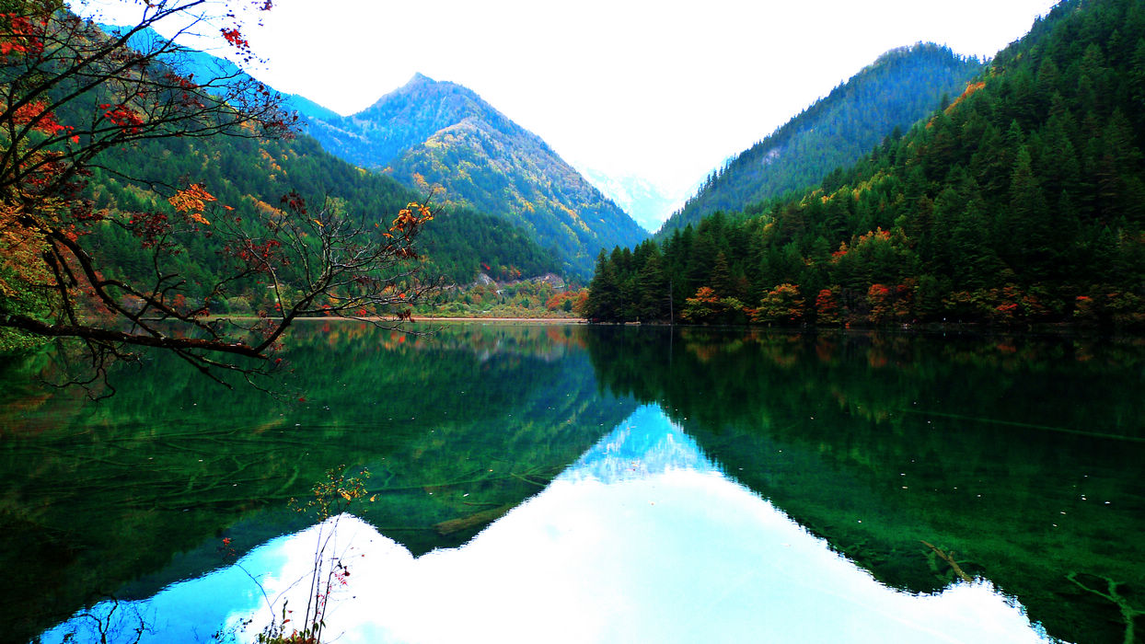
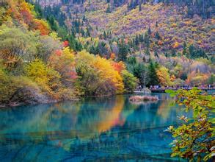
Natural Heritage

Slide 20
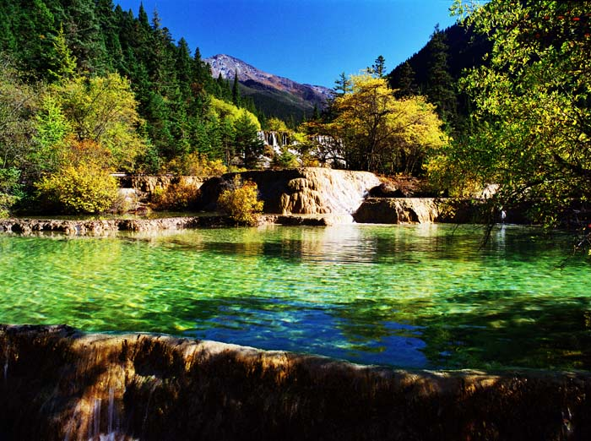
Natural Heritage
Huanglong Scenic and Historic Interest Area
Located in Songpan county, northwest of Sichuan province
Its most important feature is the outstanding karst formation.
tall arbours（乔木） and shrubs, vines, herbs and moss, as well as rare and endangered plants that only China has.
enjoys the reputation of “Kingdom of Cold Temperate Plants”.
boasts more than 30 species of national Grade-A and Grade-B protected animals

Slide 21
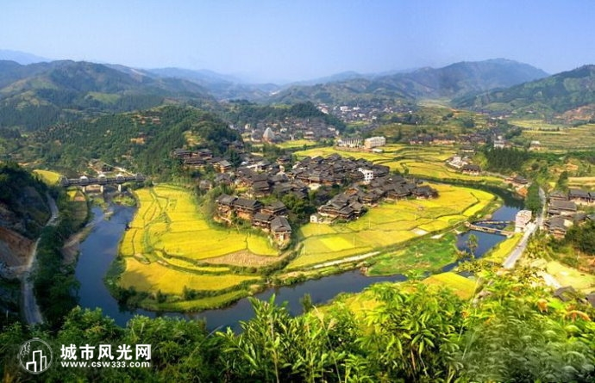
Natural Heritage
Three Parallel Rivers of Yunnan Protected Areas
Located in the mountainous northwest of Yunnan province
refer to the areas where the Jinsha River, the Lancang River and the Nujiang River flow roughly parallel through steep gorges
numerous natural resources and traditional customs of multiple ethnic minorities
harbour the richest biodiversity among the temperate areas of the world

Slide 22
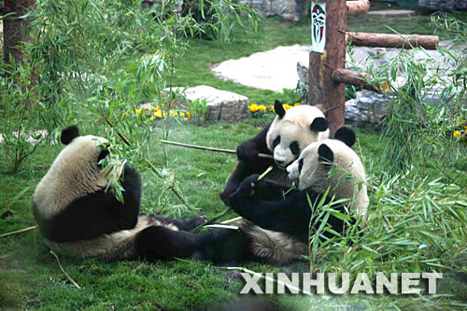
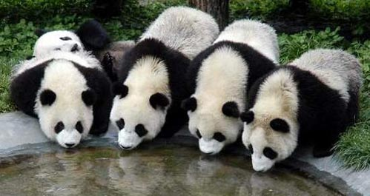
Natural Heritage
Sichuan Giant Panda Santuaries — Wolong, Mt. Siguniang
and Jiajin Mountains
located in the southwest of Sichuan province,
the largest and most intact wild panda habitat in the world (thirty percent of the wild pandas in the world are living here)
also home to other globally endangered animals

Slide 23
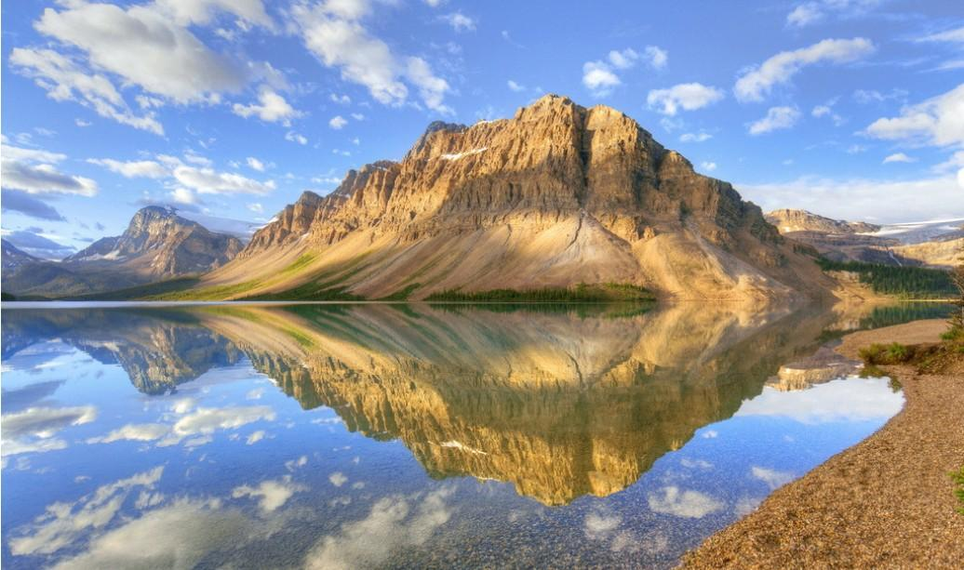
Natural Heritage
South China Karst
a unique landform that evolves in the carbonate rocks demonstrating the forces of nature.
signifies the finest examples of karst topography in China and the world.
three typical areas:
the Shilin Karst (Stone Forest) in Yunnan
the Libo Karst in Guizhou
the Wulong Karst in Chongqing

Slide 24
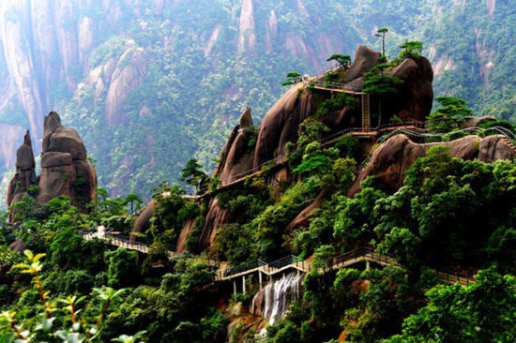
Natural Heritage
Mount Sanqingshan National Park
holds an outstanding scenery of granite peaks and pillars.
has numerous waterfalls, valleys, lakes and springs.
three main summits:
the Yujing Mountain
the Yuxu Mountain
the Yuhua Mountain.
Its visual impact is enhanced by the occurrence of meteorological（气象） effects like bright halos（光环） on clouds and white rainbows.

Slide 25
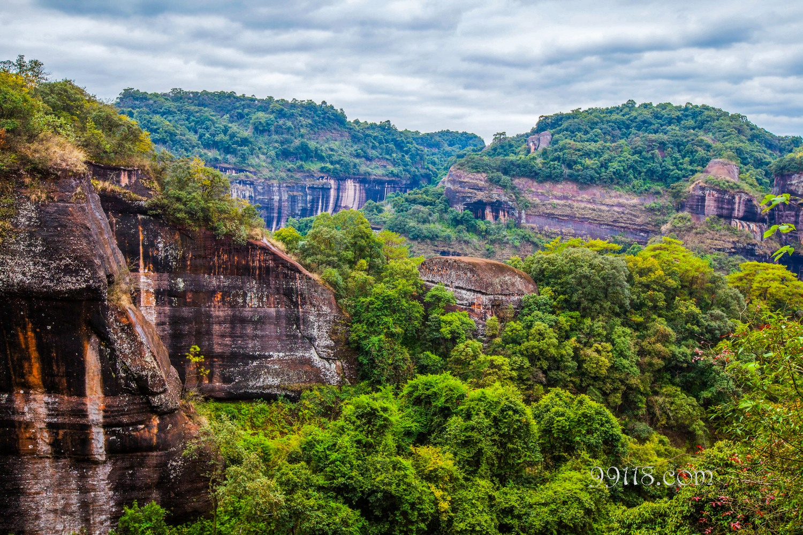
Natural Heritage
China Danxia
comprises six areas found in the subtropical zone of southwest China.
feature spectacular red cliffs and a range of erosional landforms
Conserve subtropical broad-leaved evergreen forests, and host many species of flora and fauna, about 400 of which are considered rare or threatened.

Slide 26
Natural Heritage
Chengjiang Fossil Site
located in Yunnan province
present an outstanding and extraordinarily preserved record
that testifies to the rapid diversification of life on Earth more
than 500 million years ago.
presents fossil remains of the highest quality of preservation
conveys a complete record of an early Cambrian marine
community（寒武纪时期）
one of the earliest records of a complex marine ecosystem
a unique window of understanding the structure of early
Cambrian communities

Slide 27
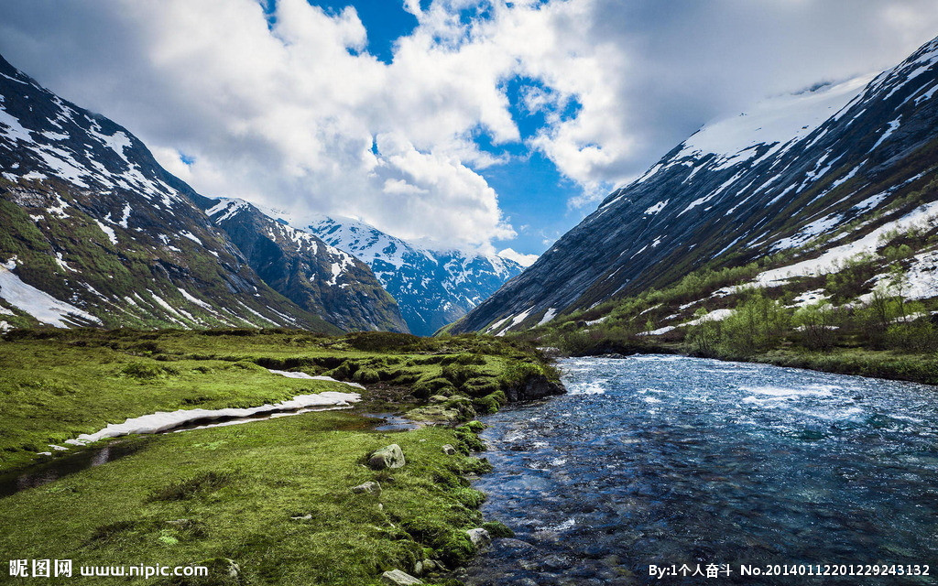
Natural Heritage
Xinjiang Tianshan
a mountain range that presents glaciers, snowcapped peaks, alpine meadows, lakes and canyons.
in stark contrast with the vast adjacent desert landscapes
The mountain area under snow line is abundant in animals and plant resources
saussurea involucrate (天山雪莲).
Heavenly Lake

Slide 28
World Heritage in China
1
2
3
4
Cultural & Natural Heritage
Natural Heritage
Cultural Heritage
Preservation

Slide 29
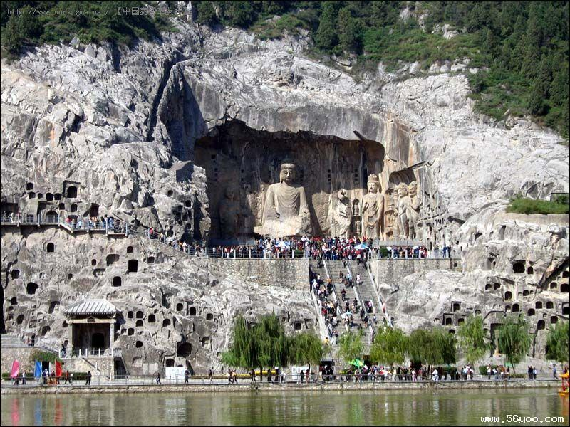
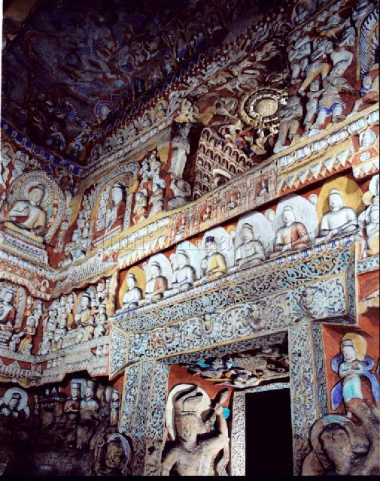
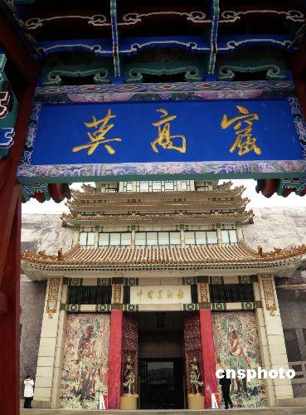
Famous Grottos
Cultural Heritage
With the wide spread of Buddhism in China in the second century, grotto arts were introduced to China from India, and developed rapidly between the second and fourth centuries.
Grottos were carved in cliff faces in various places, particularly in northern China.
The Mogao Caves in Gansu province, the Longmen Grottos in Henan province, and the Yungang Grottos in Shanxi province are called the three most important grottos in China.

Slide 30
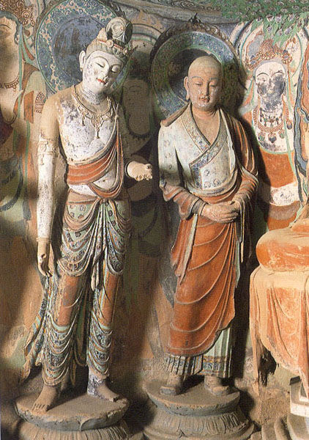
Mogao Caves
Cultural Heritage
the greatest and most consummate gallery of Buddhist art in the world.
commonly called the Thousand-Buddha Caves (Qianfodong)
initiated in 366; formed a large scale by the Yuan dynasty
492 caves, 45,000 square metres of murals and over 2,400 coloured sculptures (by now)
not only reveal the excellent mastery of art and rich imagination, but provide precious historical information for the study of ancient China.

Slide 31
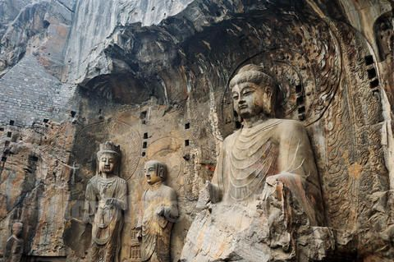
Longmen Grottos
Cultural Heritage
initially sculptured and chiseled ( 凿) around 493
an outdoor art museum of stone carvings and represents the sculptural level of that time
more than 2,300 caves and niches, over 100,000 statues (by now)
the biggest statue:17.14 metres high
the smallest statue: centimetres high.
The Guyang Cave (古阳洞) and the Binyang Cave (宾阳洞) contain the most representative statues.

Slide 32
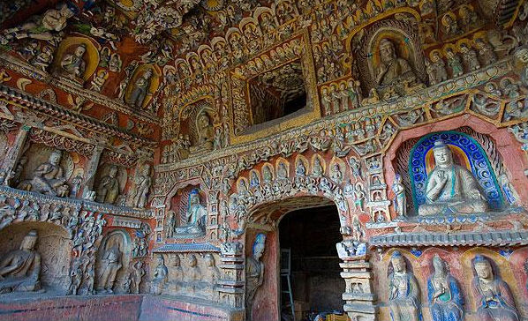
Yungang Grottos
Cultural Heritage
situated at the foot of the Wuzhou Mountain near Datong city, Shanxi province
chiseled out of cliff-sides in a honeycomb pattern, stretching as long as one kilometre from east to west
53 extant caves, 110 niches ,more than 51,000 statues
The sculptural works at Yungang are noted for their fleshy, vigorous features and rich variety.
The statues of all kinds are vivid and lifelike.

Slide 33
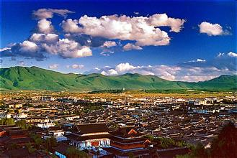
Famous Ancient Cities
Cultural Heritage
Old Town of Lijiang
a large Naxi ( 纳西) settlement first built during the Southern Song dynasty in Yunnan province
has a rich reserve of land, forest, minerals and tourist resources.
The Yulong Snow Mountain
numerous streams and brooks
a unique culture and a long history
As a famous historic and cultural city, Lijiang attracts numerous tourists every year.

Slide 34
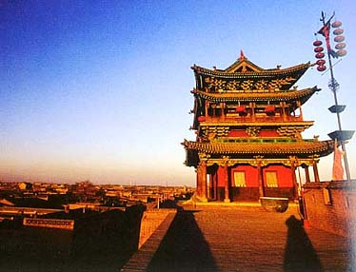
Famous Ancient Cities
Cultural Heritage
Ancient City of Pingyao
located in central Shanxi province
first built during the West Zhou dynasty and expanded during the Ming dynasty
a typical sample of ancient cities in the central part of the country
has been well preserved and can be regarded as the mirror of the cities in the Ming and Qing dynasties

Slide 35
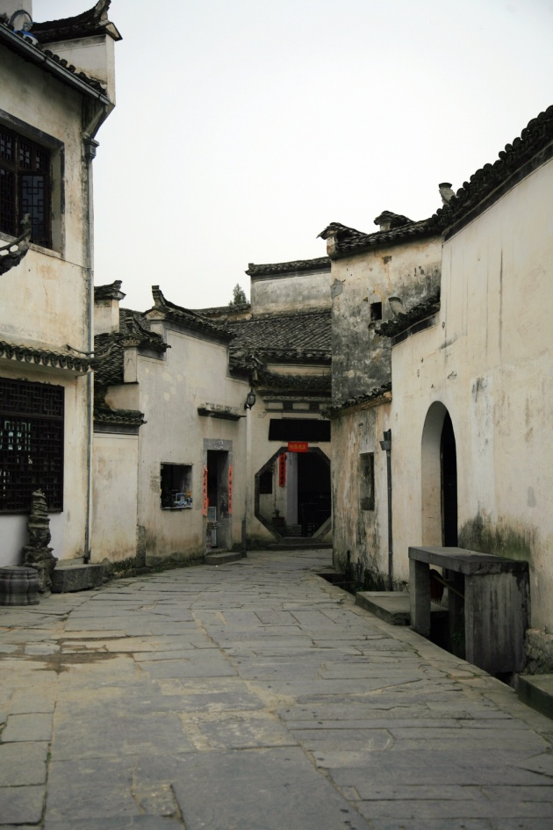
Famous Ancient Cities
Cultural Heritage
Xidi and Hongcun (西递与宏村)
Located in Yixian county, Anhui province
reputed as “living ancient residential museums”
Xidi Village
built during the Northern Song dynasty
one of the most representative scenic spots of ancient Hui architecture
originally a compact community of the families with the surname Hu
now has 124 old residential houses and three ancestral temples of the Ming and Qing dynasties

Slide 36
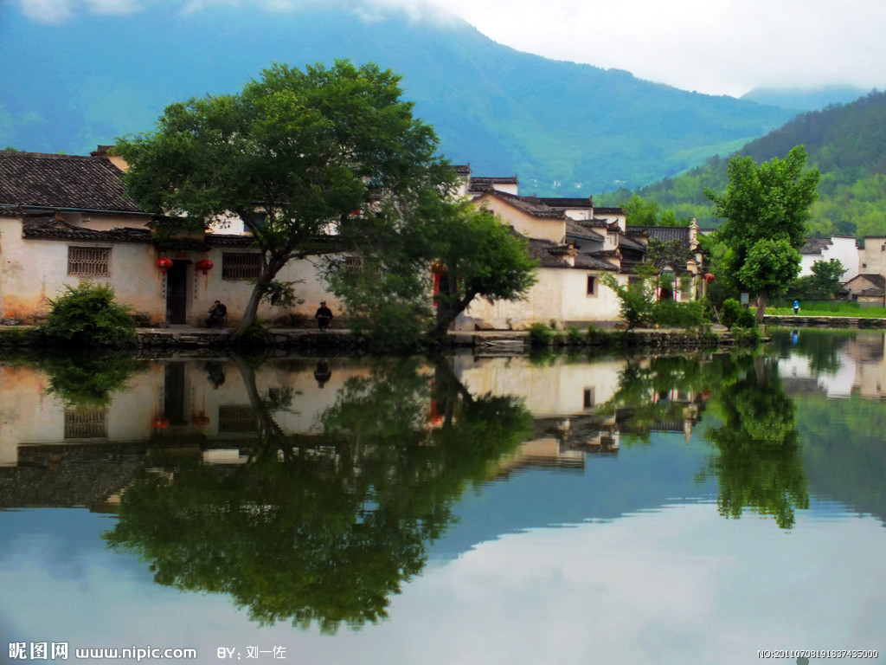
Famous Ancient Cities
Cultural Heritage
Xidi and Hongcun (西递与宏村)
Hongcun Village
about 15 kilometres away from Xidi
built in the Southern Song dynasty
distinguishes itself by its water system and narrow streets
was arranged in the shape of a buffalo with an artificial water system on the basis of bionics ( 仿生学).
Xidi and Hongcun are typical representatives of the culture of feudal society in the later stage of China—the carrier of Huizhou culture.

Slide 37
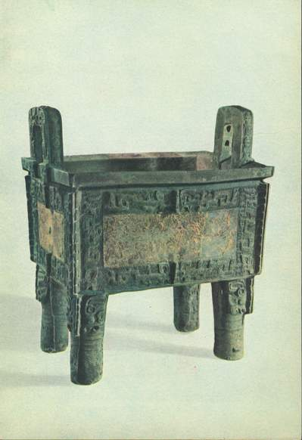
Famous Ancient Cities
Cultural Heritage
Yin Xu
located at Anyang, Henan province
the site of the ancient capital city of the late Shang dynasty.
provided rich and crucial materials for the study of history.
Important relics :
oracle bone inscriptions (甲骨文)
Simuwu Tripod (司母戊方鼎)
the largest piece of bronze ware relic of that time ever found in the world
shows the high level of craftsmanship and economic and cultural development of the late Shang dynasty.

Slide 38
World Heritage in China
1
2
3
4
Cultural & Natural Heritage
Natural Heritage
Cultural Heritage
Preservation

Slide 39
The Preservation of World Heritage
Preservation
World Heritage Sites List by UNESCO
financial and technical aid
better known and protected worldwide
two major criteria for: the site’s value and the state of its preservation
a continuous process of conservation
The Chinese government has always attached great importance to protecting world cultural and natural heritage sites.
Cultural and natural heritage is the identity of a nation and the value of a society. Therefore, we must preserve it for future generations.

Slide 40
1
2
Overview
3
Lead-in Activity
World Heritage
in China
Discussion &
Presentation

Slide 41

Discussion
China has successfully got 45 sites put on the World Heritage List by UNESCO (2013), which attract more and more tourists. But there is still a long way for China to go in increasing people’s awareness of protecting the World Heritage Sites. Please discuss with your partner:
What effective measures should the government and people take to protect these sites?
Then share your ideas with the class.

Slide 42
Students’ Presentation
There will be an international forum held in China to discuss the protection of intangible cultural heritage in the world.
You, as a Chinese student representative, are required to give a presentation on the protection of China’s intangible cultural heritage such as Chinese tea culture, kung fu, acupuncture, etc. in the forum. Choose one example to present your opinions.
Your presentation should cover the following points:
1. the history of the intangible cultural heritage;
2. its present state;
3. effective measures to protect it.

Slide 43

The End

